Slide 1

Developing AI in Games
Understanding Artificial Intelligence
and Artificial Stupidity

Slide 2

DEADLINE:
15th November 2022 / 18:00
PLATFORM:
TEAMS
Required Folders to submit in a zip file:
1- /Source/
2- /Content/Blueprints
3- /Config/
ASSIGNMENT #1:
ATTACK/DAMAGE SYSTEM
Make the avatar only damage the facing enemies. Damaging multiple enemies is okay!
Add a secondary attack button (Right Mouse). This attack will be slower, use a different animation, has more damage area and inflict more damage.
Make the enemies chase and melee attack the player.They should stop attacking if the player is dead.
Enemies should also hit the player if they are facing him/her.
Make enemies move faster than default. (MaxWalkSpeed > 100)

Slide 3
AI Overview
I think, therefore I am.—Not a robot

Slide 4

What is AI?
In games, AI typically refers to the implementation of seemingly intelligent behavior in various game agents. AI types can have significant differences in the following:
How they process tasks
How they receive and “perceive” information about the world
How they understand the spatial rules and layout of the world
How they are adapted to more closely approximate human behavior
How they react to outside stimuli

Slide 5
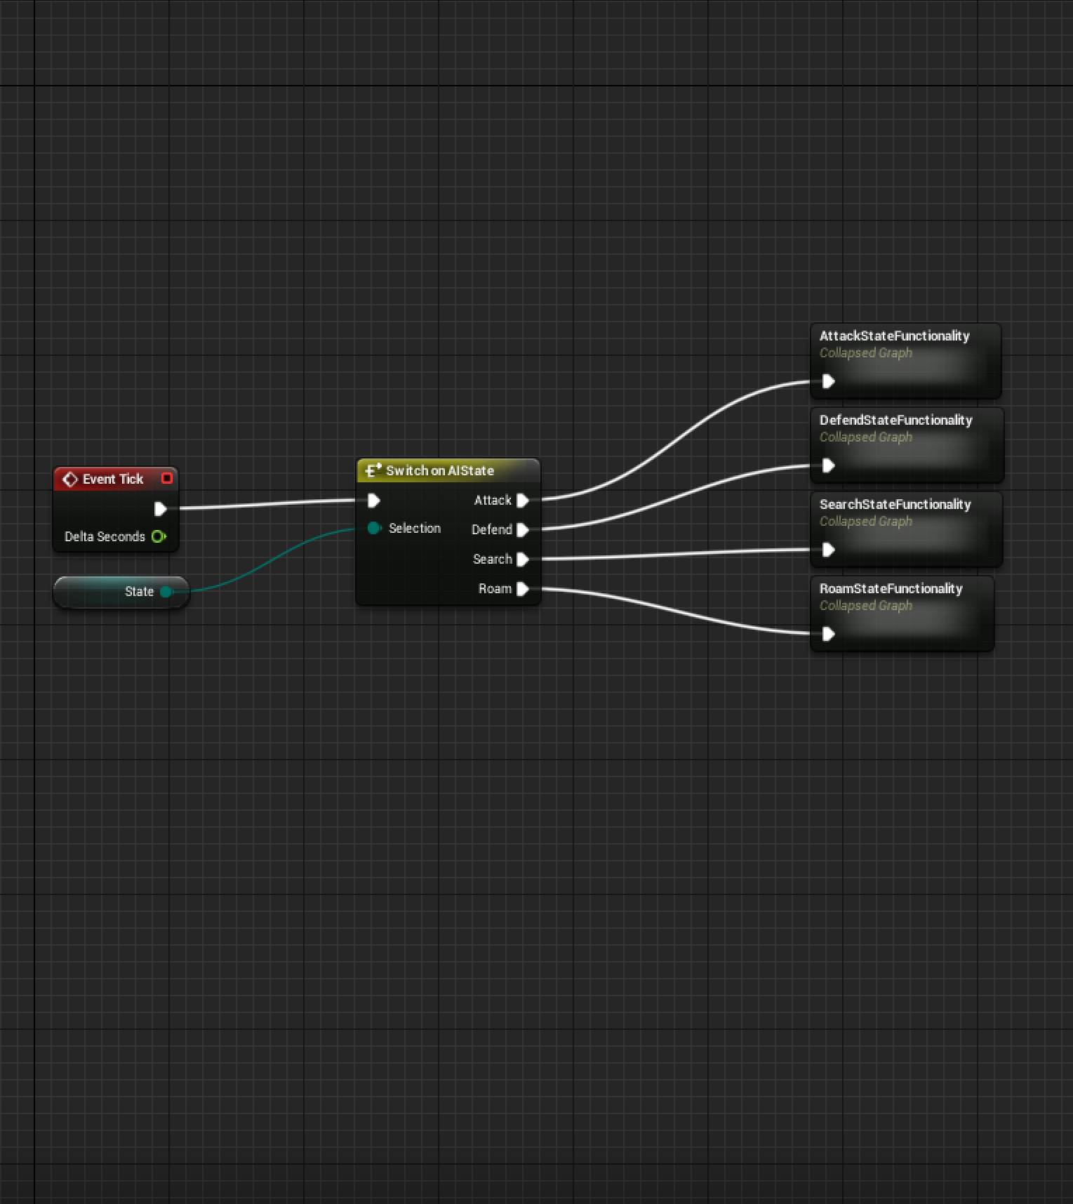
State Machines
Often AI behaviors can be broken into individual states. For instance, enemy AI may have states for searching for enemies, searching for health, engaging enemies, and general idle behavior. By defining transition rules, these states can be organized into a structure called a “Finite State Machine” or a “Finite State Automata.” This is a very simple but powerful technique that is applicable in many different situations. State machines have historically been one of the main types of design patterns underneath most AI structures.

Slide 6
AI Systems in UE4
Behavior Trees and EQS

Slide 7
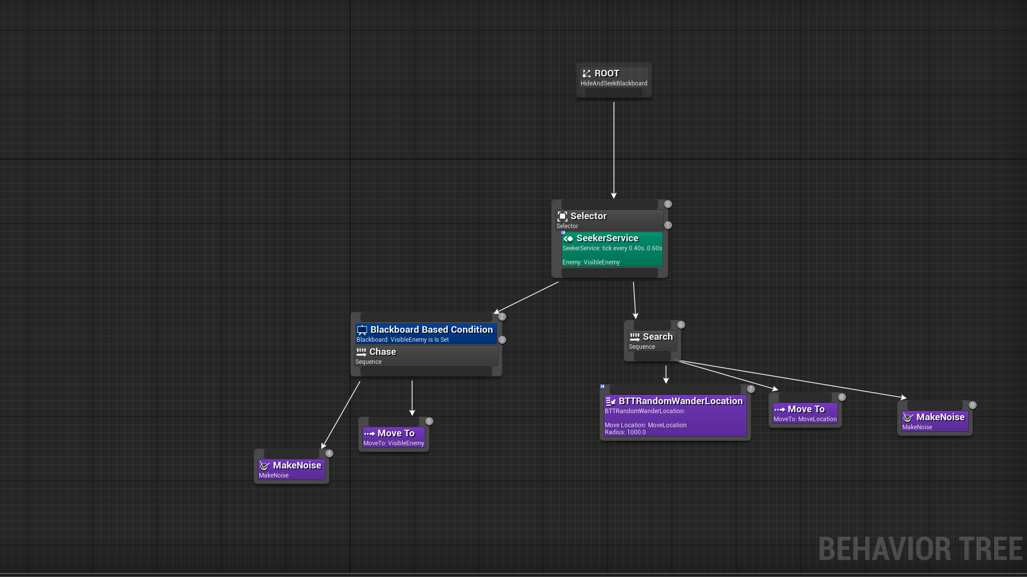
Behavior Trees
A useful technique for describing AI behaviors is a Behavior Tree. A Behavior Tree consists of hierarchically organized nodes that control the flow of decision making and determine a set of actions to execute in a given situation. This is the most common type of AI setup in Unreal Engine 4.

Slide 8

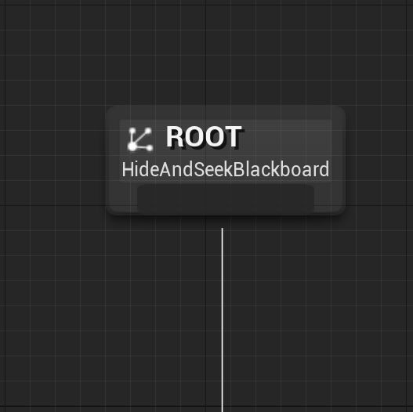
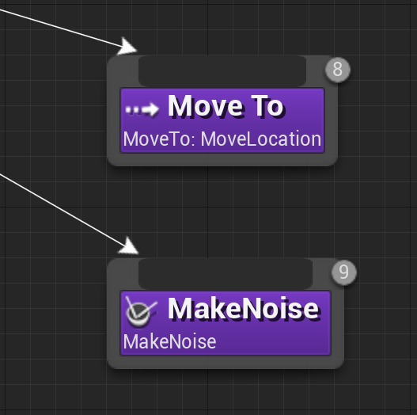
Root Node
Task Nodes
Root
Tasks
The Root Node is unique in the Behavior Tree and is the starting point for the Behavior Tree. It can only have one connection, and you cannot attach Decorators or Services to it.
Task Nodes are the leaves of the Behavior Tree, the nodes that “do” things and don’t have an output connection.

Slide 9
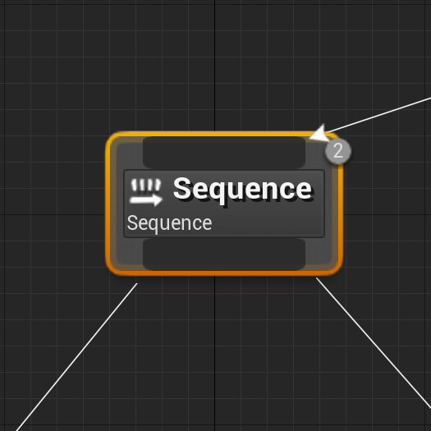
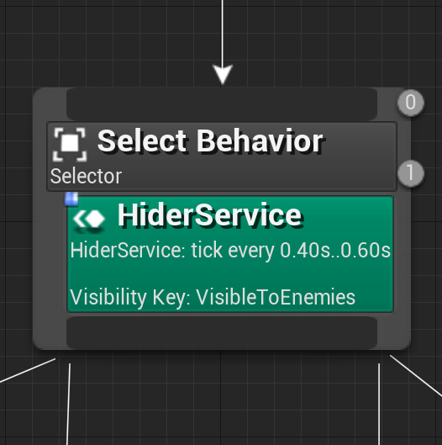
Sequence Node
Selector Node
Composite: Sequence
Composite: Selector
Sequence Nodes execute their children from left to right and will stop executing their children when one of their children fails. If a child fails, then the Sequence fails. If all the Sequence’s children succeed, then the Sequence succeeds.
Selector Nodes execute their children from left to right and will stop executing their children when one of their children succeeds. If a child succeeds, the Selector succeeds. If all the Selector’s children fail, the Selector fails.

Slide 10
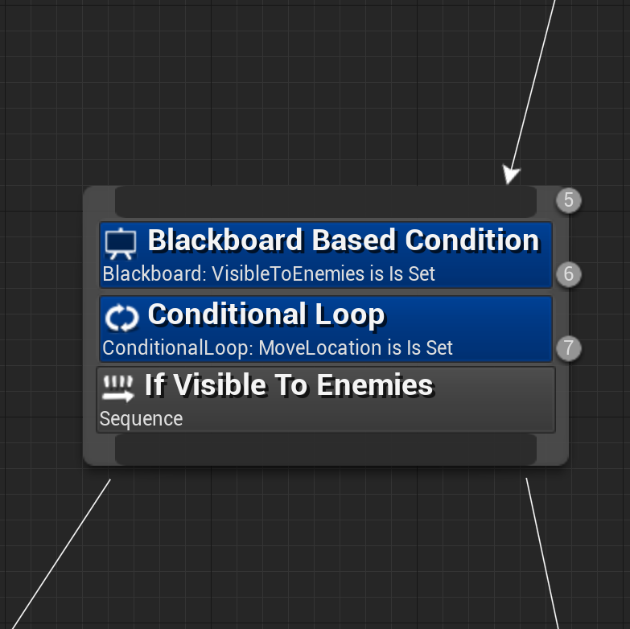
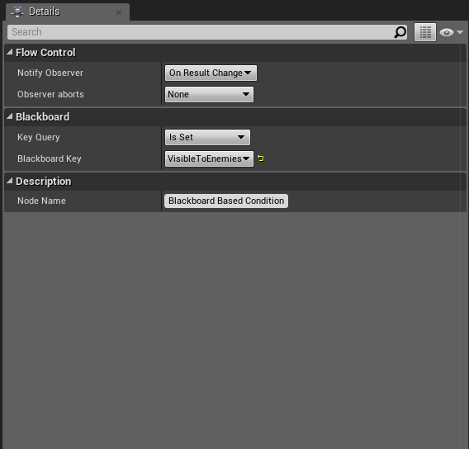
Simple Decorator
Observer
Decorators
Observers
Decorators are also known as conditionals. They attach to another node and make decisions about whether or not a branch in the tree, or even a single node, can be executed.
Observers are a property of a decorator node that can observe values in the Blackboard and abort the execution of the branch if necessary.

Slide 11
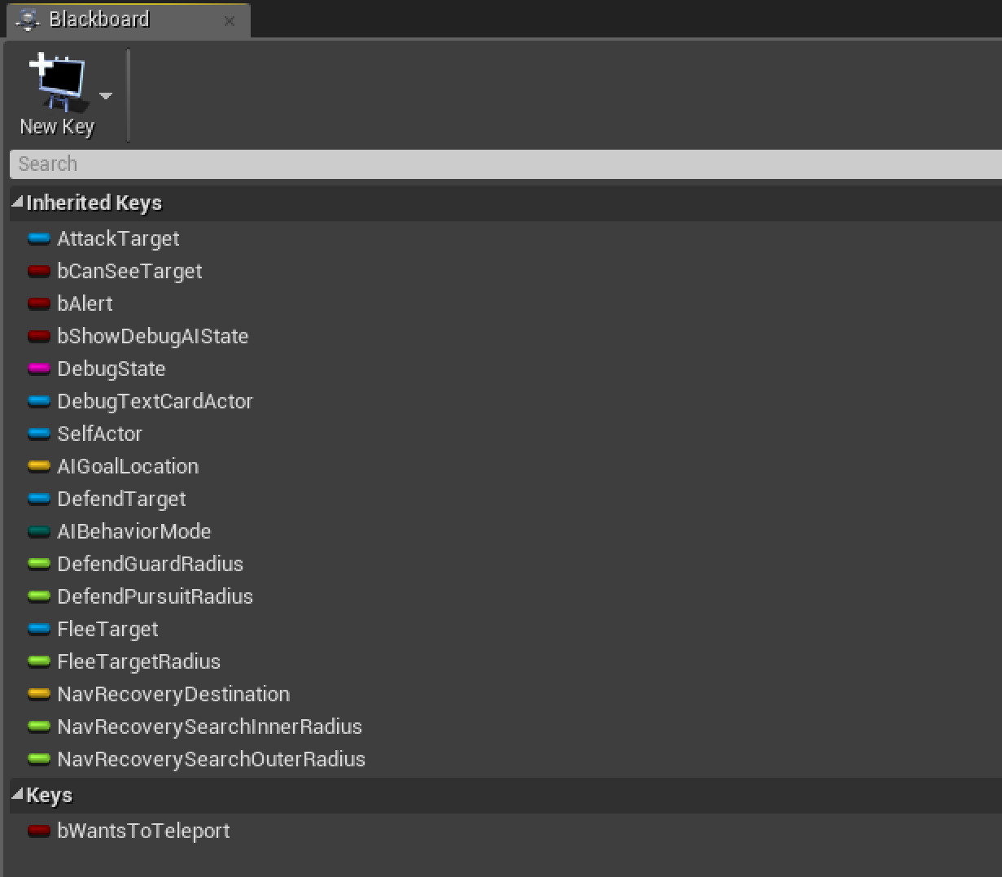
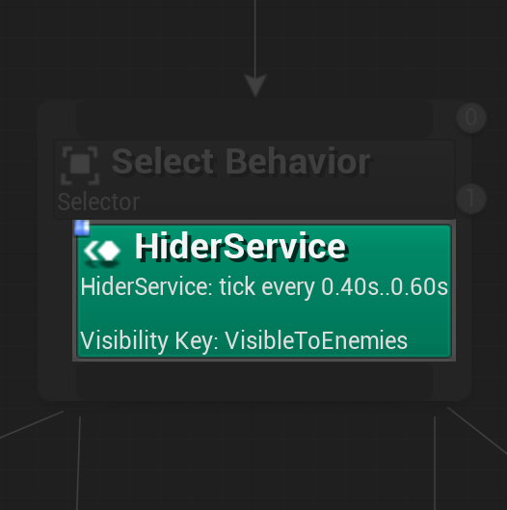
Blackboard
Service
Blackboards
Services
The Blackboard is the AI’s memory. It stores key values for the Behavior Tree to use.
Services attach to Composite nodes and will execute at their defined frequency as long as their branch is being executed. They are often used to make checks and to update the Blackboard.

Slide 12
AI Information
Gathering
While AI can potentially access any information at any stage, it’s important to simulate human behavior and perception constraints. For this reason, it’s common to check when characters are within a certain radius of the AI and to perform intermittent traces to see if there is a clear line of sight between the player and the enemy. The enemy locations are usually compared using a dot product to ensure they’re in the same direction as the AI’s head; however, this is not always the case.

Slide 13
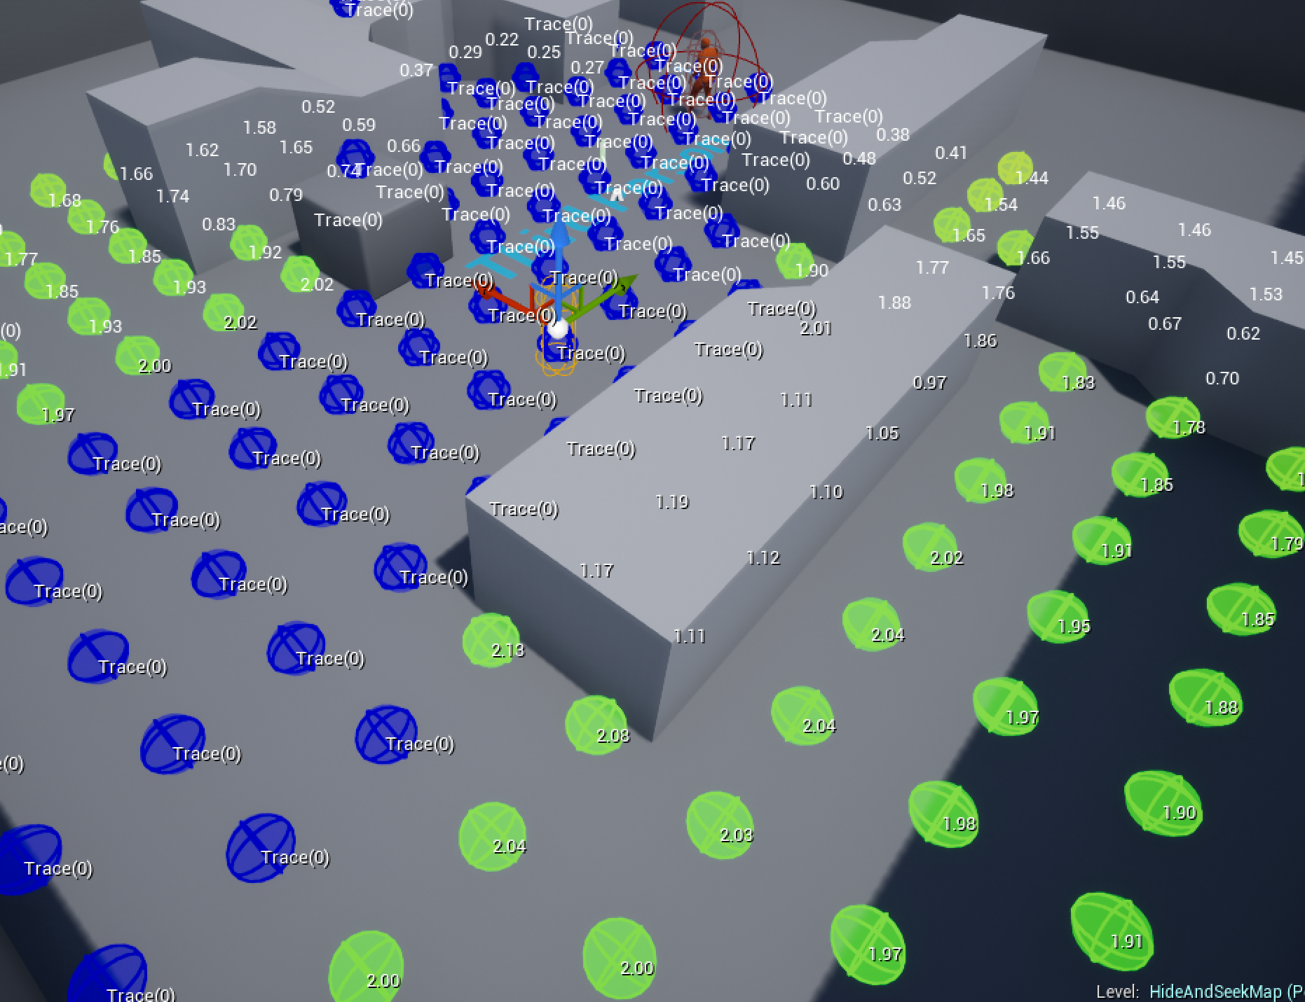
Environment Query System (EQS)
The Environment Query System is a feature of the artificial intelligence system in Unreal Engine 4 for collecting data on the environment, asking questions of the data through Tests, then returning the one item that best fits the tests performed. You can use it to find the closest power-up, to figure out which enemy is the greatest threat, or to find cover.
EQS provides fast tests to feed world data to AI systems.

Slide 14
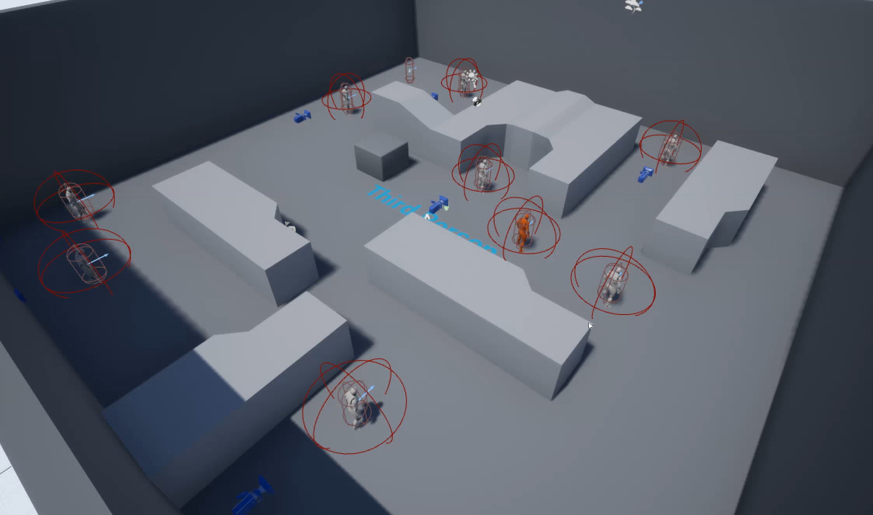
Hide and Seek AI: Example Video
In this video, you can see a group of white AI characters using EQS to find hiding places away from any red characters.
Both sets of AI characters use EQS to hide from or seek the other team.

Slide 15
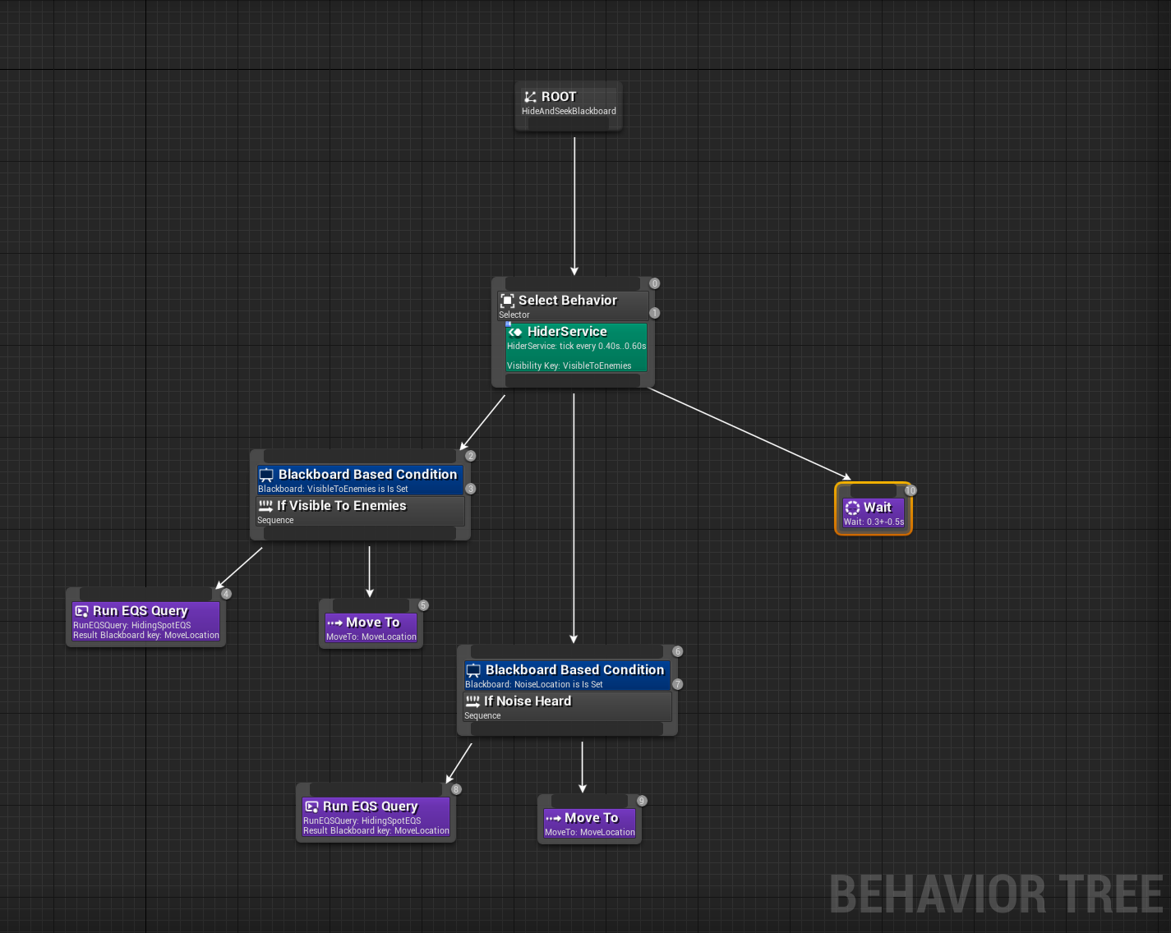
Hide and Seek AI: Behavior Tree
The Hider Service determines whether the AI can currently be seen or not. If the AI is visible or can hear an enemy coming, it will relocate itself to a better position. If it can’t hear anyone coming or is not visible to an enemy, it’ll wait before reconsidering these parameters.
The Behavior Tree for “Hiding”

Slide 16
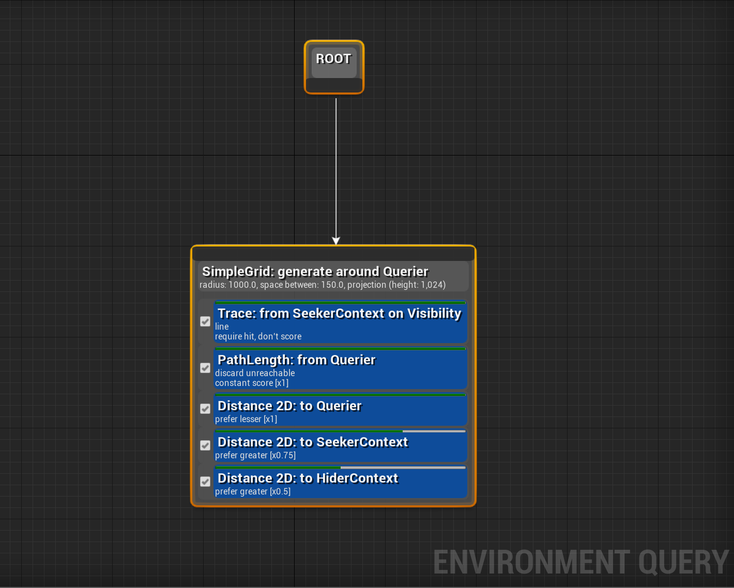
Hide and Seek AI: EQS
The EQS Query does the following:
Traces between the point and any known “Seeker” (the term we used for the searching team in Hide and Seek)
Discards any unreachable points in the grid
Evaluates the distance to the player (prefers closer points)
Evaluates the distance from any Seeker (prefers farther points)
Evaluates the distance to any other “hiders” to look for separate hiding places
EQS Setup for finding a hiding spot

Slide 17
HIDE AND SEEK GAME
IMPLEMENTATION

Slide 18
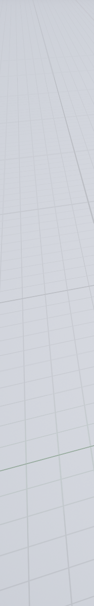
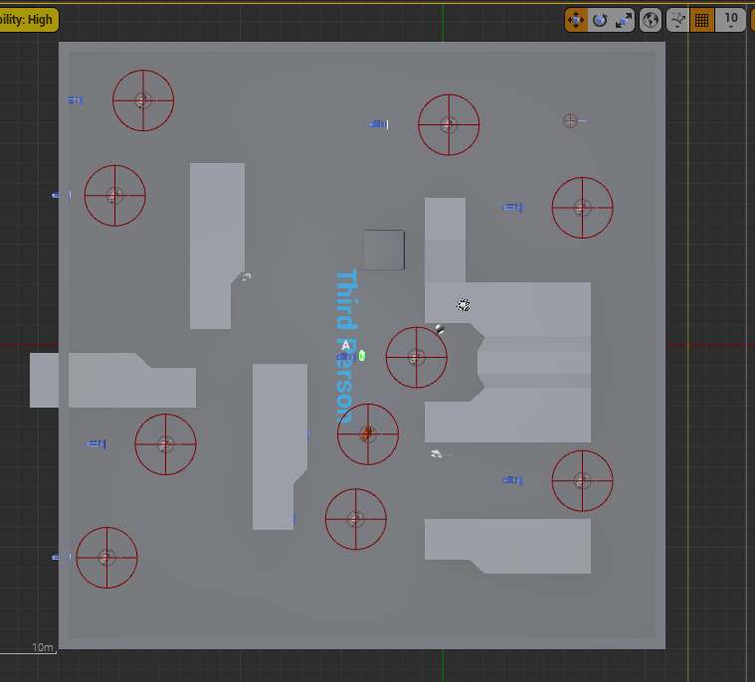
MAP_HIDESEEK
Create «AI» subfolder under Blueprints folder.
Duplicate and rename ThirdpersonExampleMap to MAP_HideAndSeek
Re-arrange the layout like this:

Slide 19
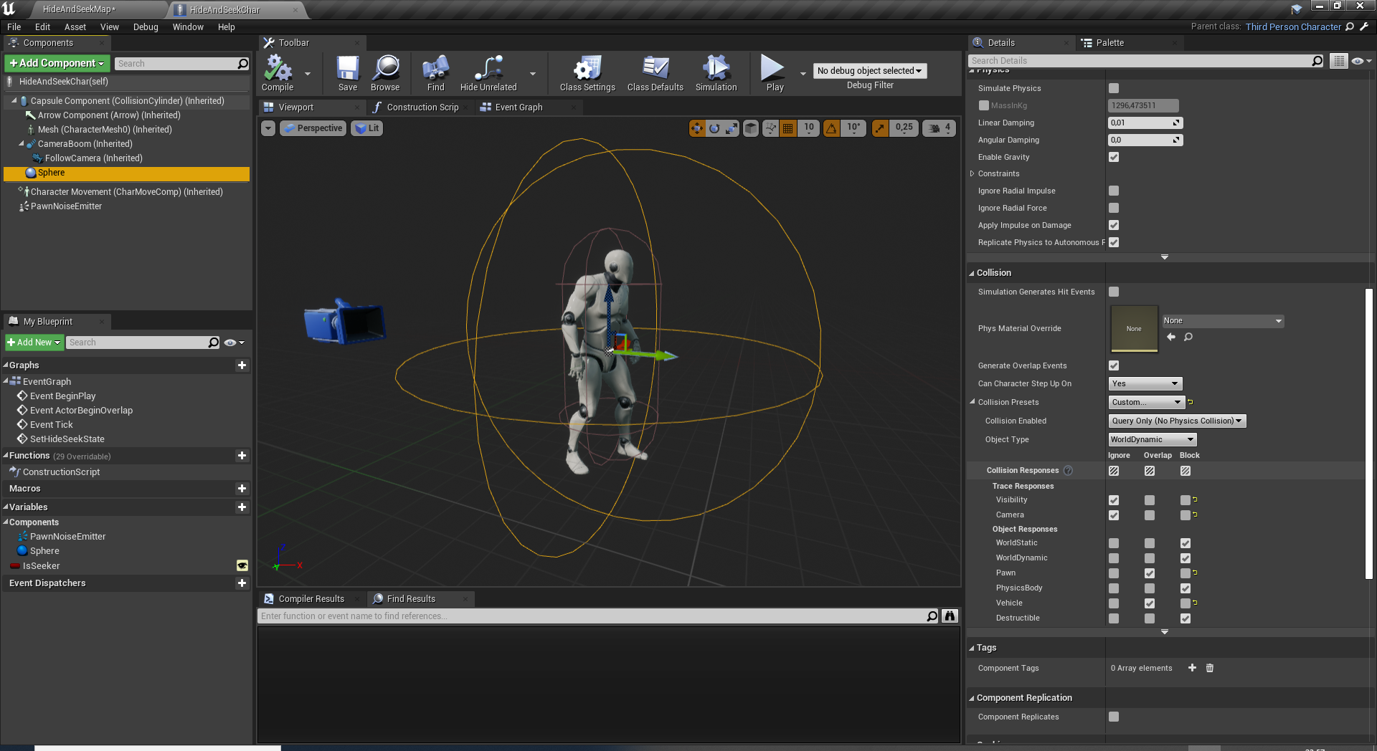
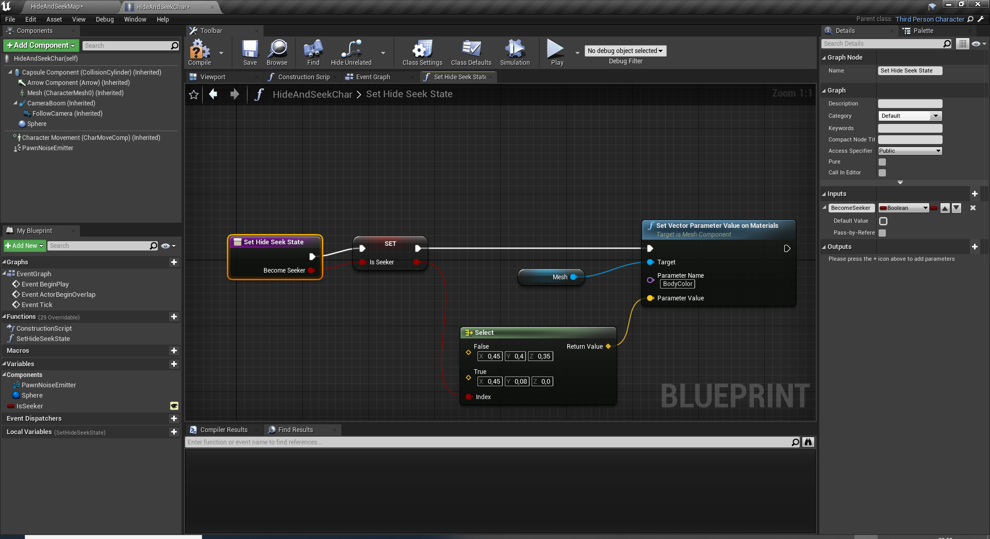
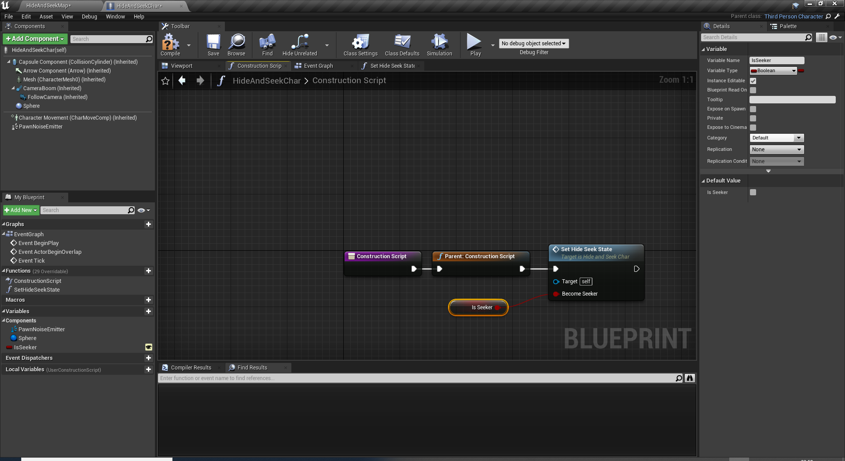
BP_HideSeekChar
Duplicate and rename ThirdpersonCharacter to BP_HideSeekChar and move to Blueprints/AI folder.
Change World Override for the gamemode to GameMode. This provide a flying camera to observe the behaviour of AI.
Add a SphereCollision (Radius=150) with this collision settings.
Add IsSeeker boolean variable.
Add SetHideSeekState function and call it at ConstructionScript.
Add a PawnNoiseEmitter component.

Slide 20
Players
Place all the AI players like this.
Set only one to Seeker by settings the boolean to true.
Add a NavMeshBoundsVolume and scale it to cover the whole map. Press «P» to see and test it.

Slide 21
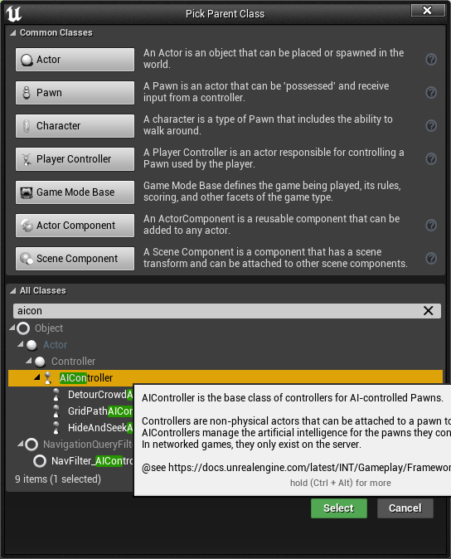
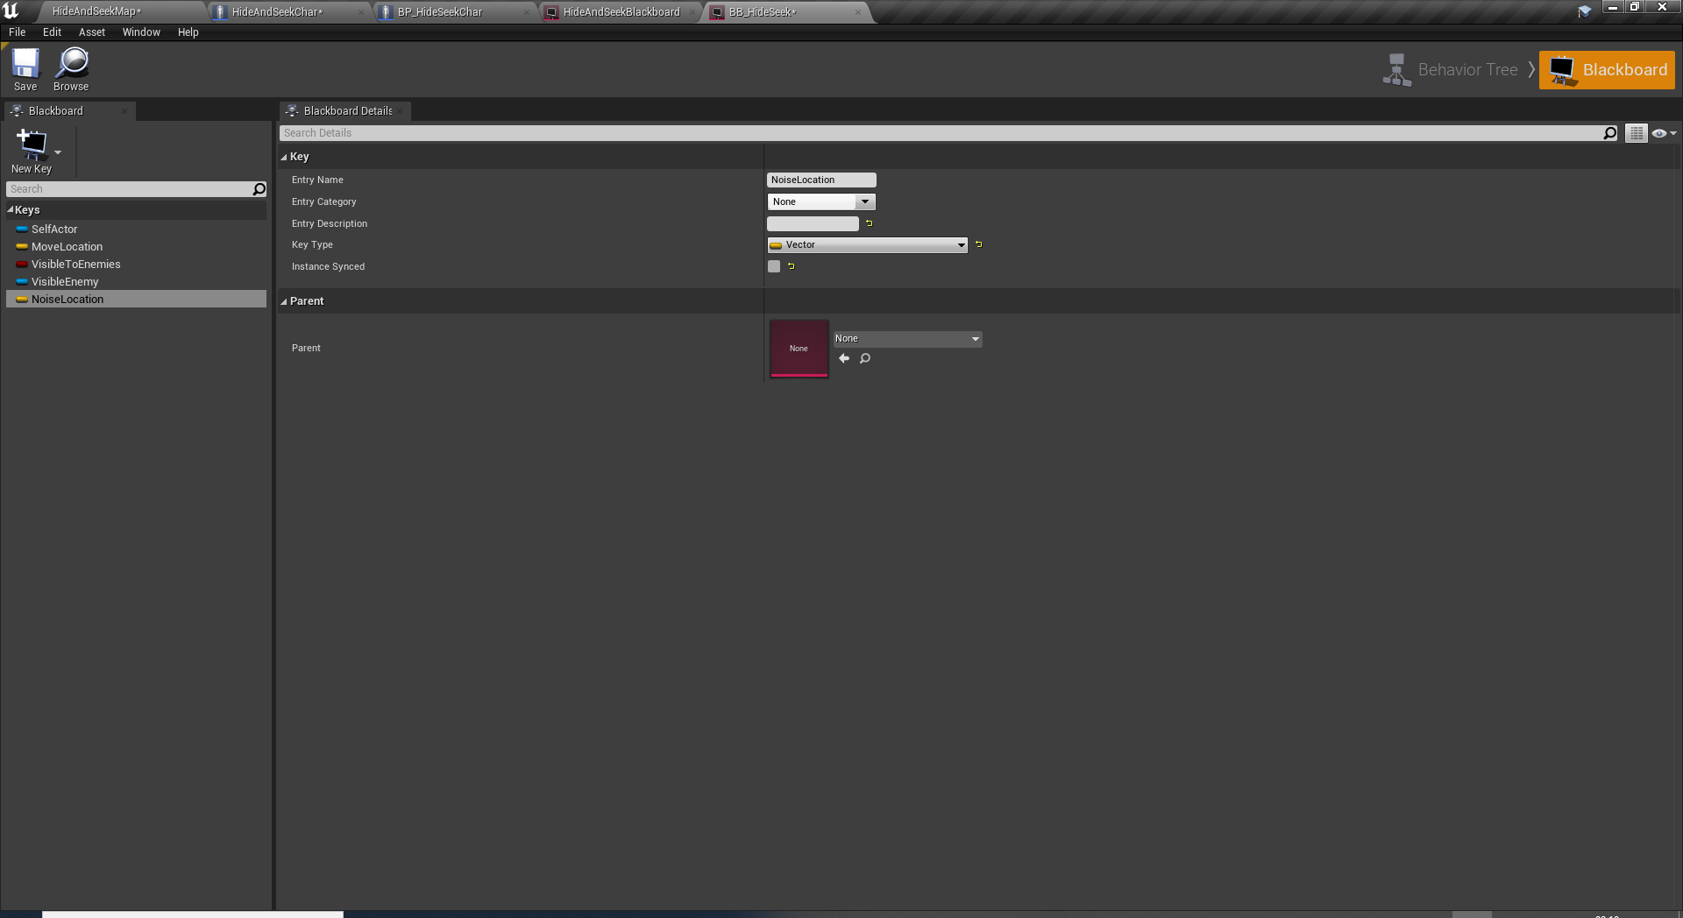
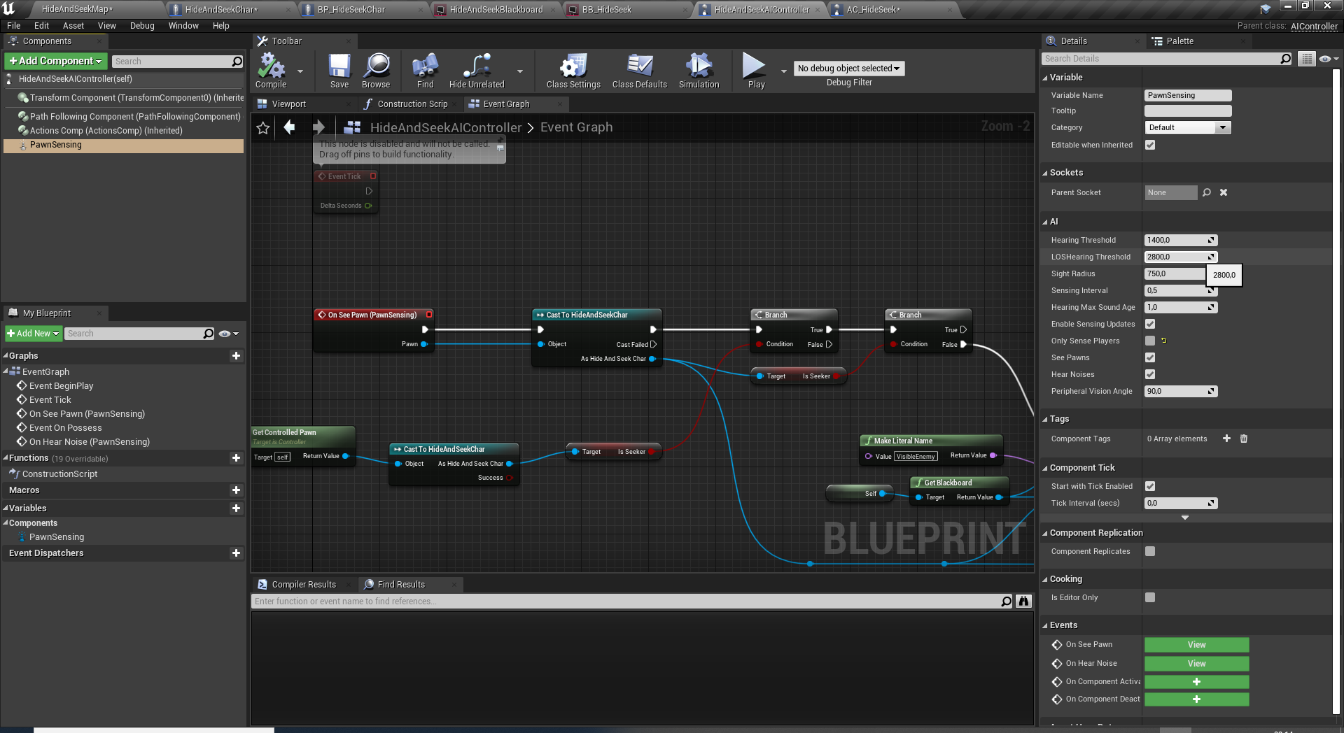
AI SETUP
Create a Blackboard from Artificial Intelligence -> Blackboard and name it to BB_HideSeek
Open it and 4 new keys: MoveLocation, VisibleToEnemies, VisibleEnemy and NoiseLocation.
Create a new blueprint derived from AIController and name it to AC_HideSeek
Open it and add a PawnSensing component to it.
Edit PawnSensing properties as SightRadius:750 and OnlySensePlayer: false.

Slide 22
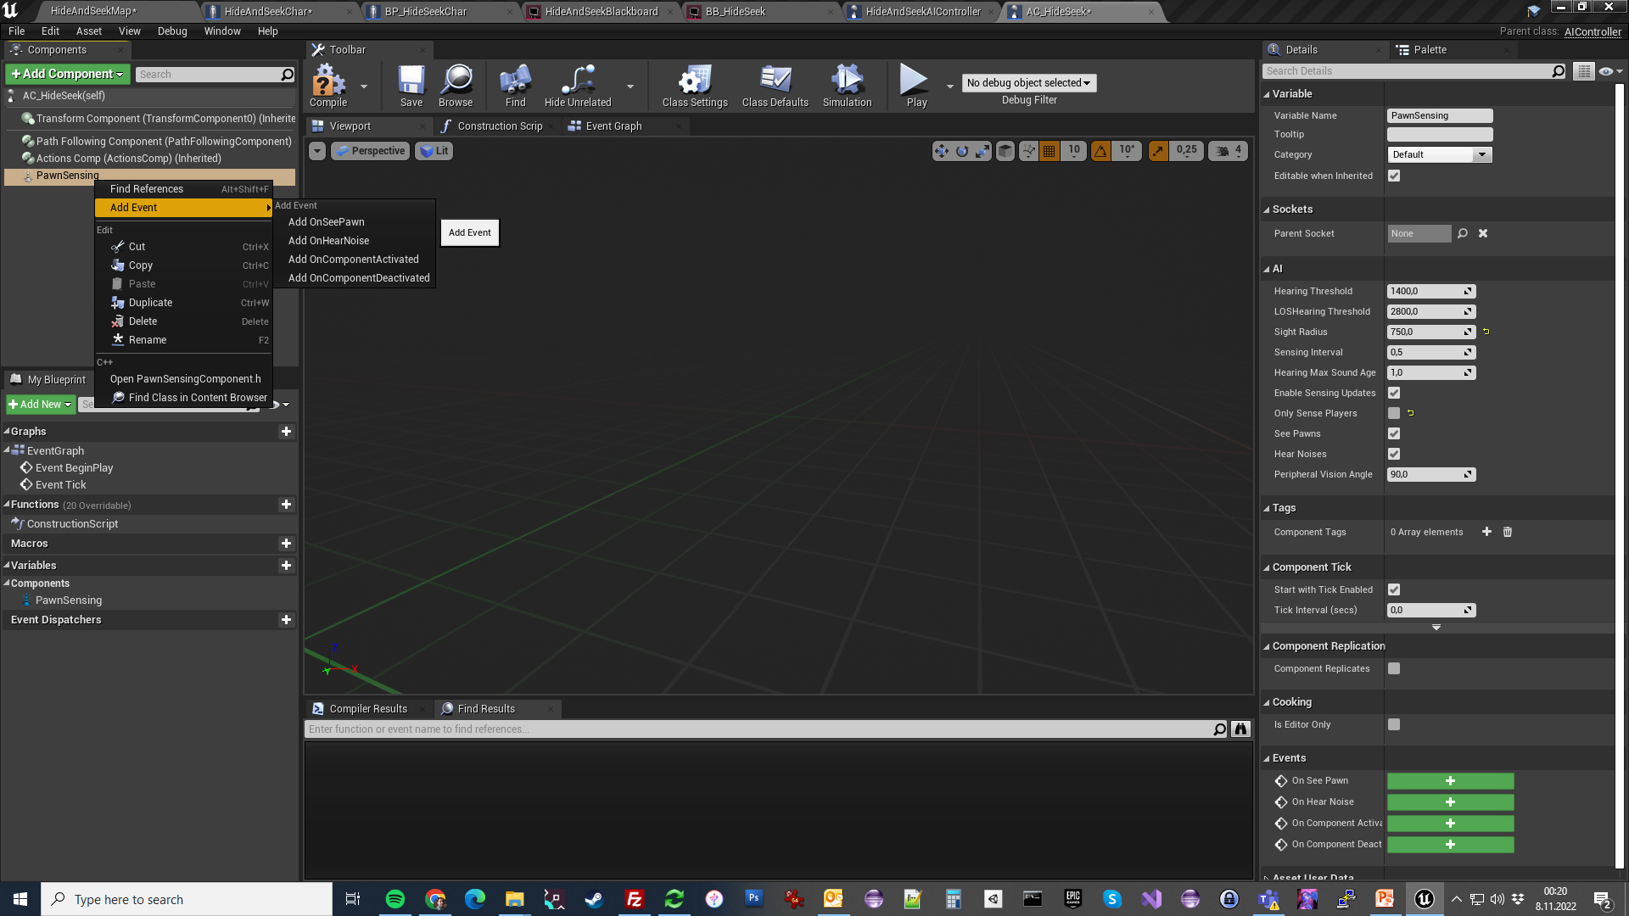
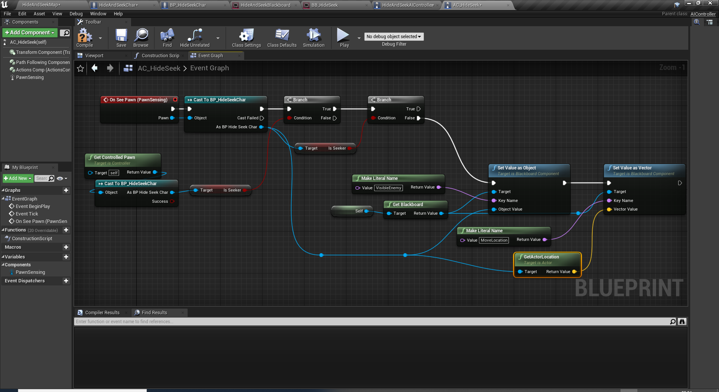
AI SETUP
Add PawnSensing OnSeePawn event.

Slide 23
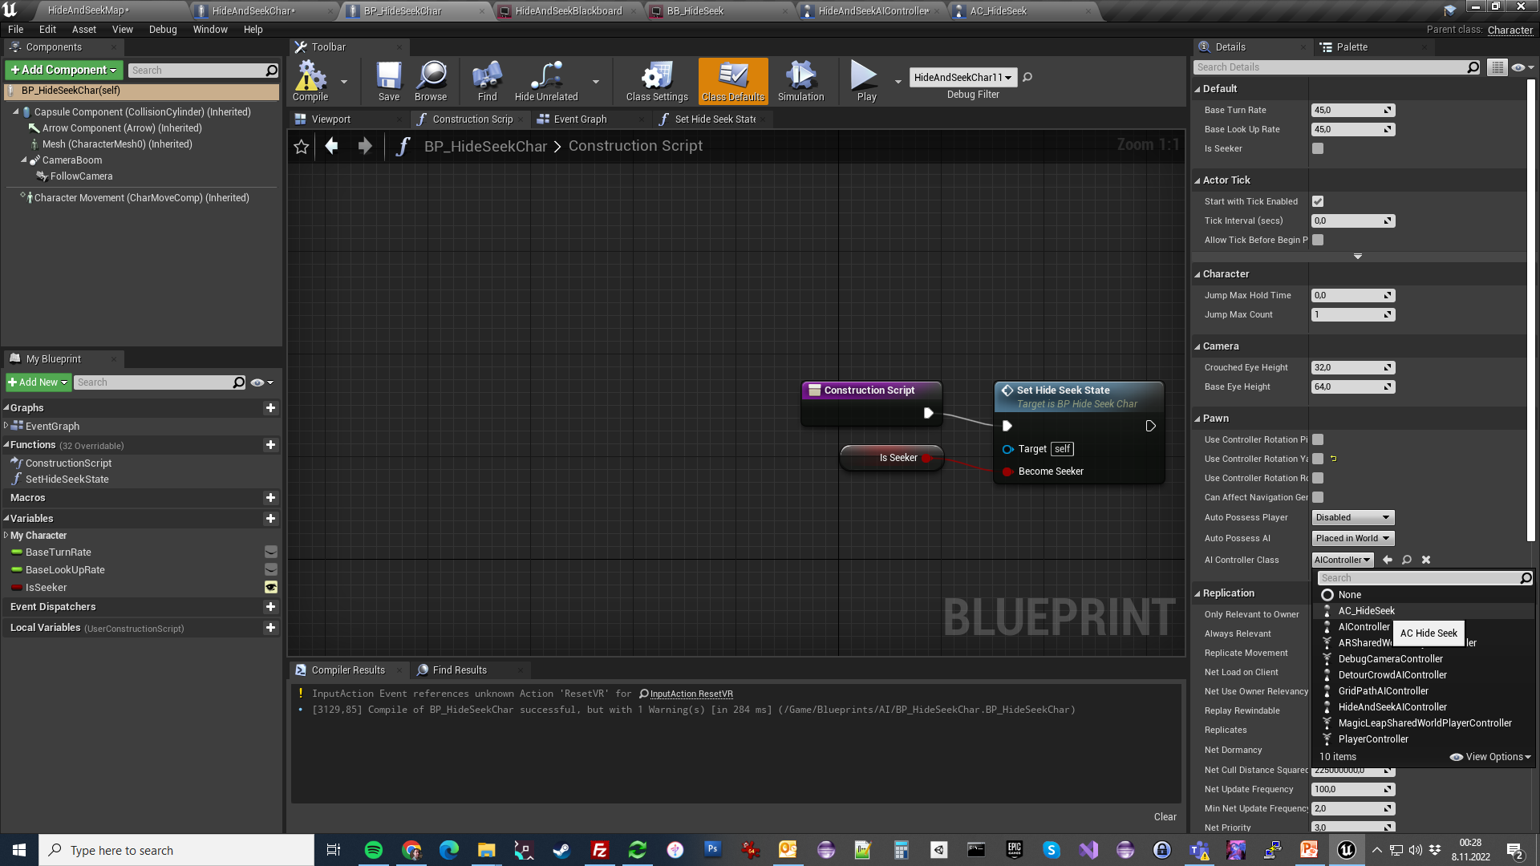
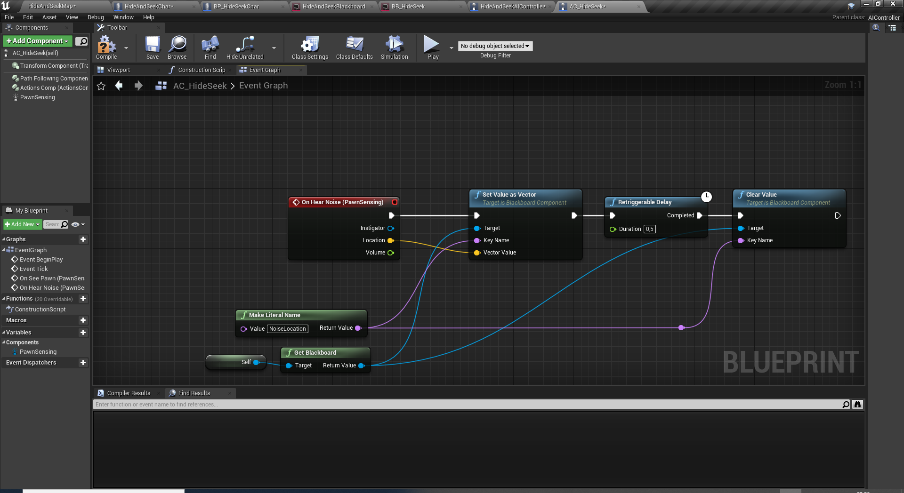
AI SETUP
Add PawnSensing OnHearNoise event.
Go back to BP_HideSeekChar Class Defaults and assign AC_HideSeek as the default AIController Class.

Slide 24
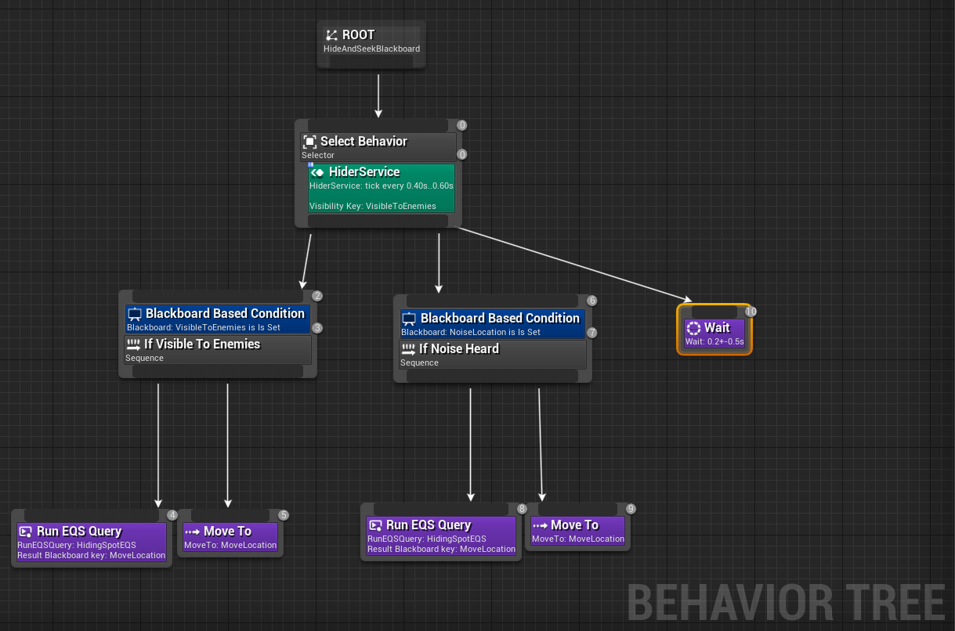
HIDING BEHAVIOUR

Slide 25
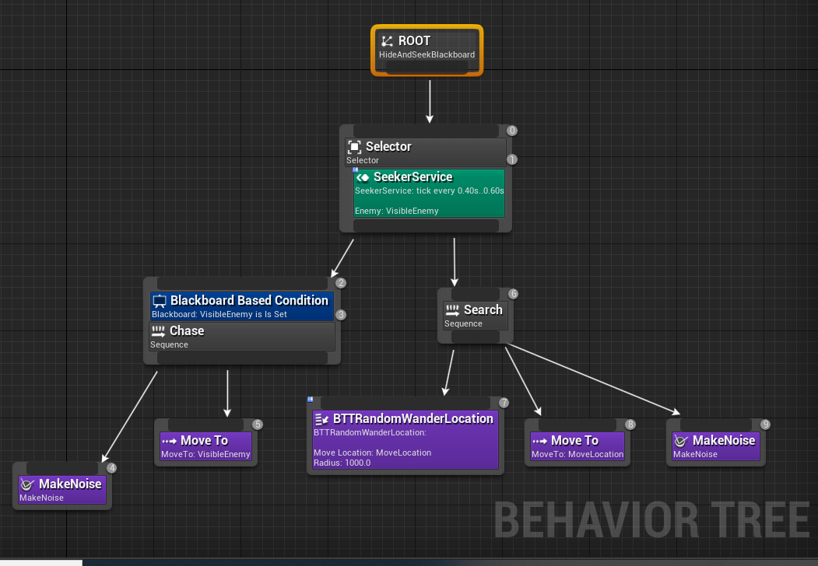
SEEKER BEHAVIOUR

Slide 26
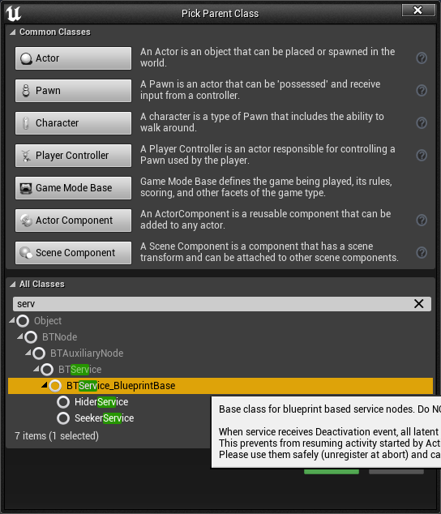
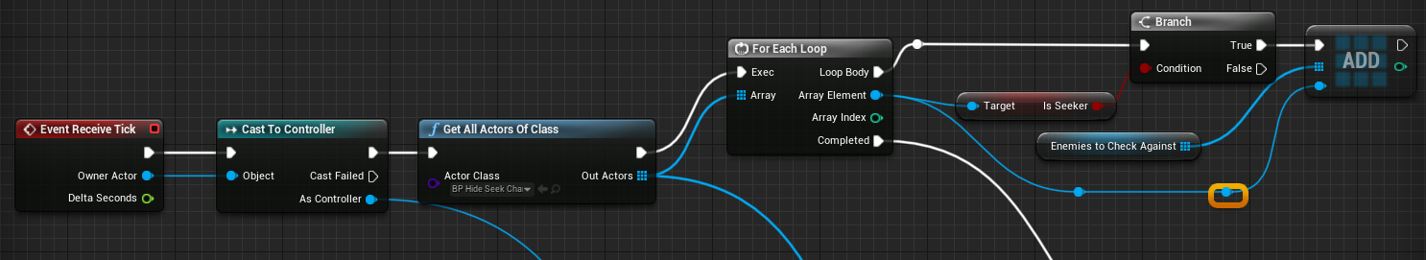
HIDING SERVICE
Add Blueprint class drived from BTService_BlueprintBase
Name it to BTS_Hide
Override Event Receive Task and implement a logic to get a list of all seeker characters currently in the game.

Slide 27
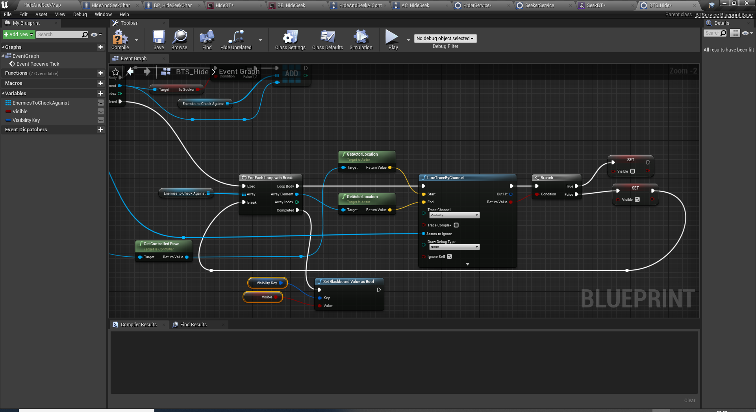
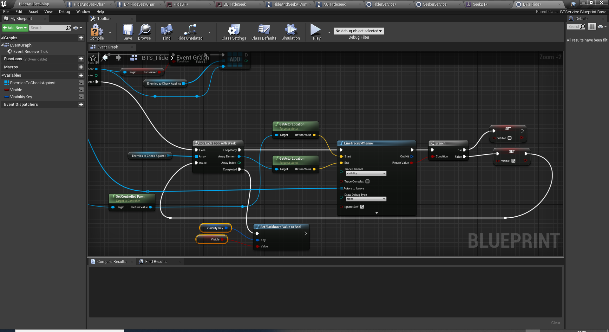
Add new variables for holding the array of seekers to check against if this character’s in their line of sight.
VisibiltyKey is key id holder to be edited in Behaviour Tree later on.
HIDING SERVICE (CONTINUTED)

Slide 28
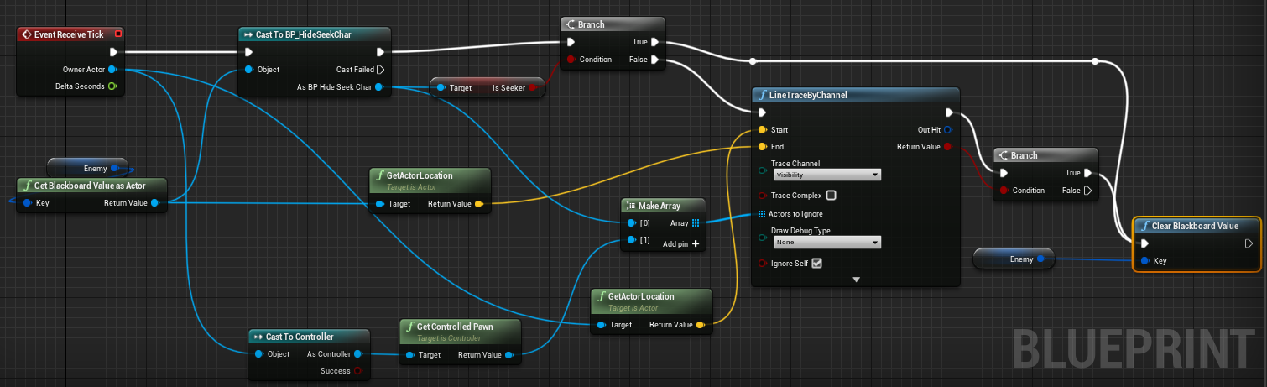
SEEKER SERVICE
Add Blueprint class drived from BTService_BlueprintBase
Name it to BTS_Seek
If an enemy is set by the AI Controller, then we need to check the line of sight here. The idea is we shouldn’t hit anything on the way. (Enemy is also in the ignore list here.)

Slide 29
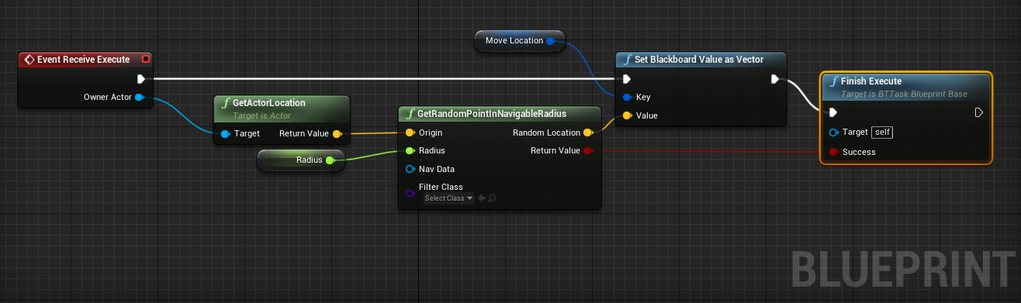
RANDOM LOCATION TASK
Add Blueprint class drived from BTTask_BlueprintBase
Name it to BTT_RandomLocation
Override Event Receive Execute as to pick a random navigable point around the seeker.

Slide 30
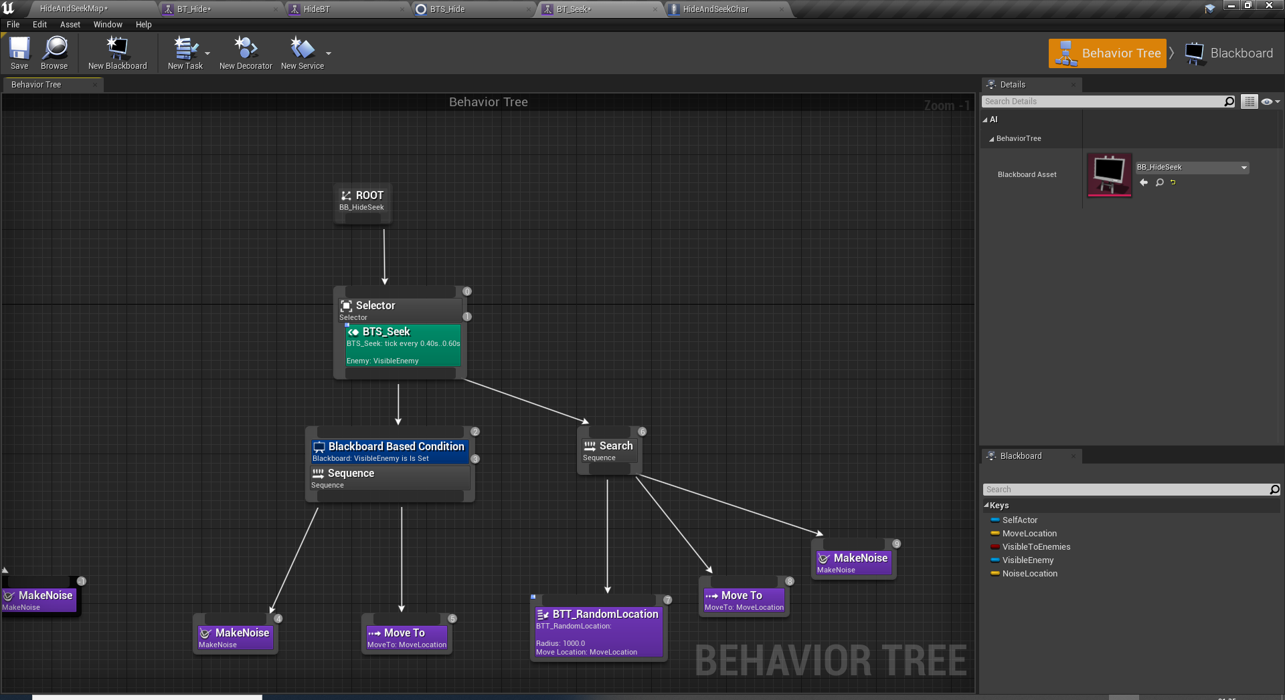
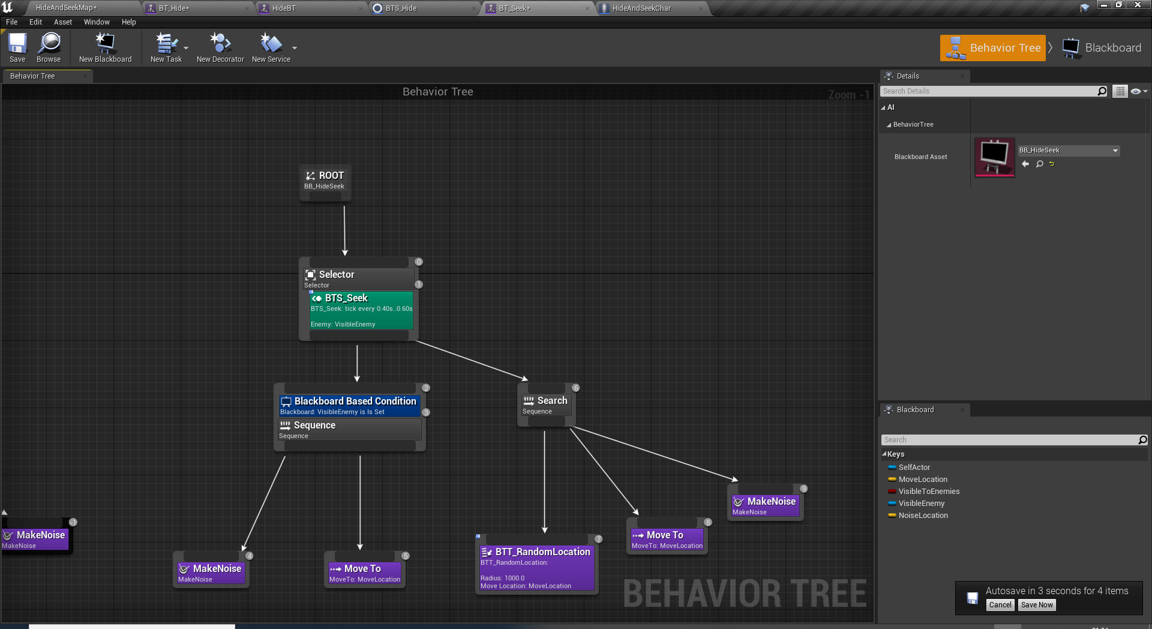
SEEKER BEHAVIOUR
Add Blueprint class from Artificial Intelligence -> Behaviour Tree
Name it to BT_Seek
Open it and set blackboard data to BB_HideSeek.
Implement the graph as here.
Also create Behaviour tree for hiding BT_Hide and keep it empty for now.

Slide 31
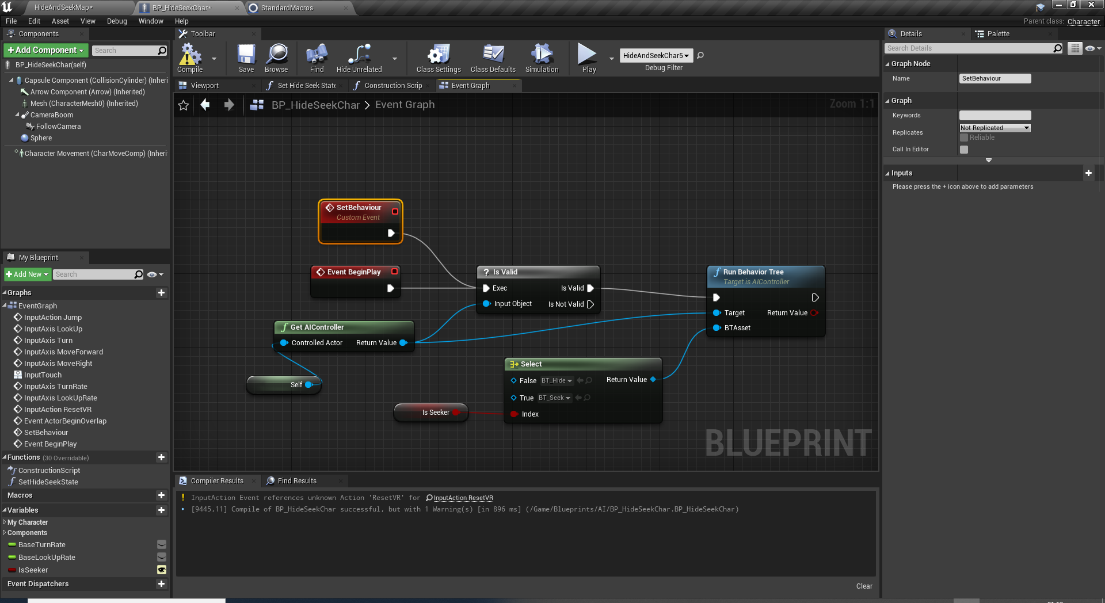
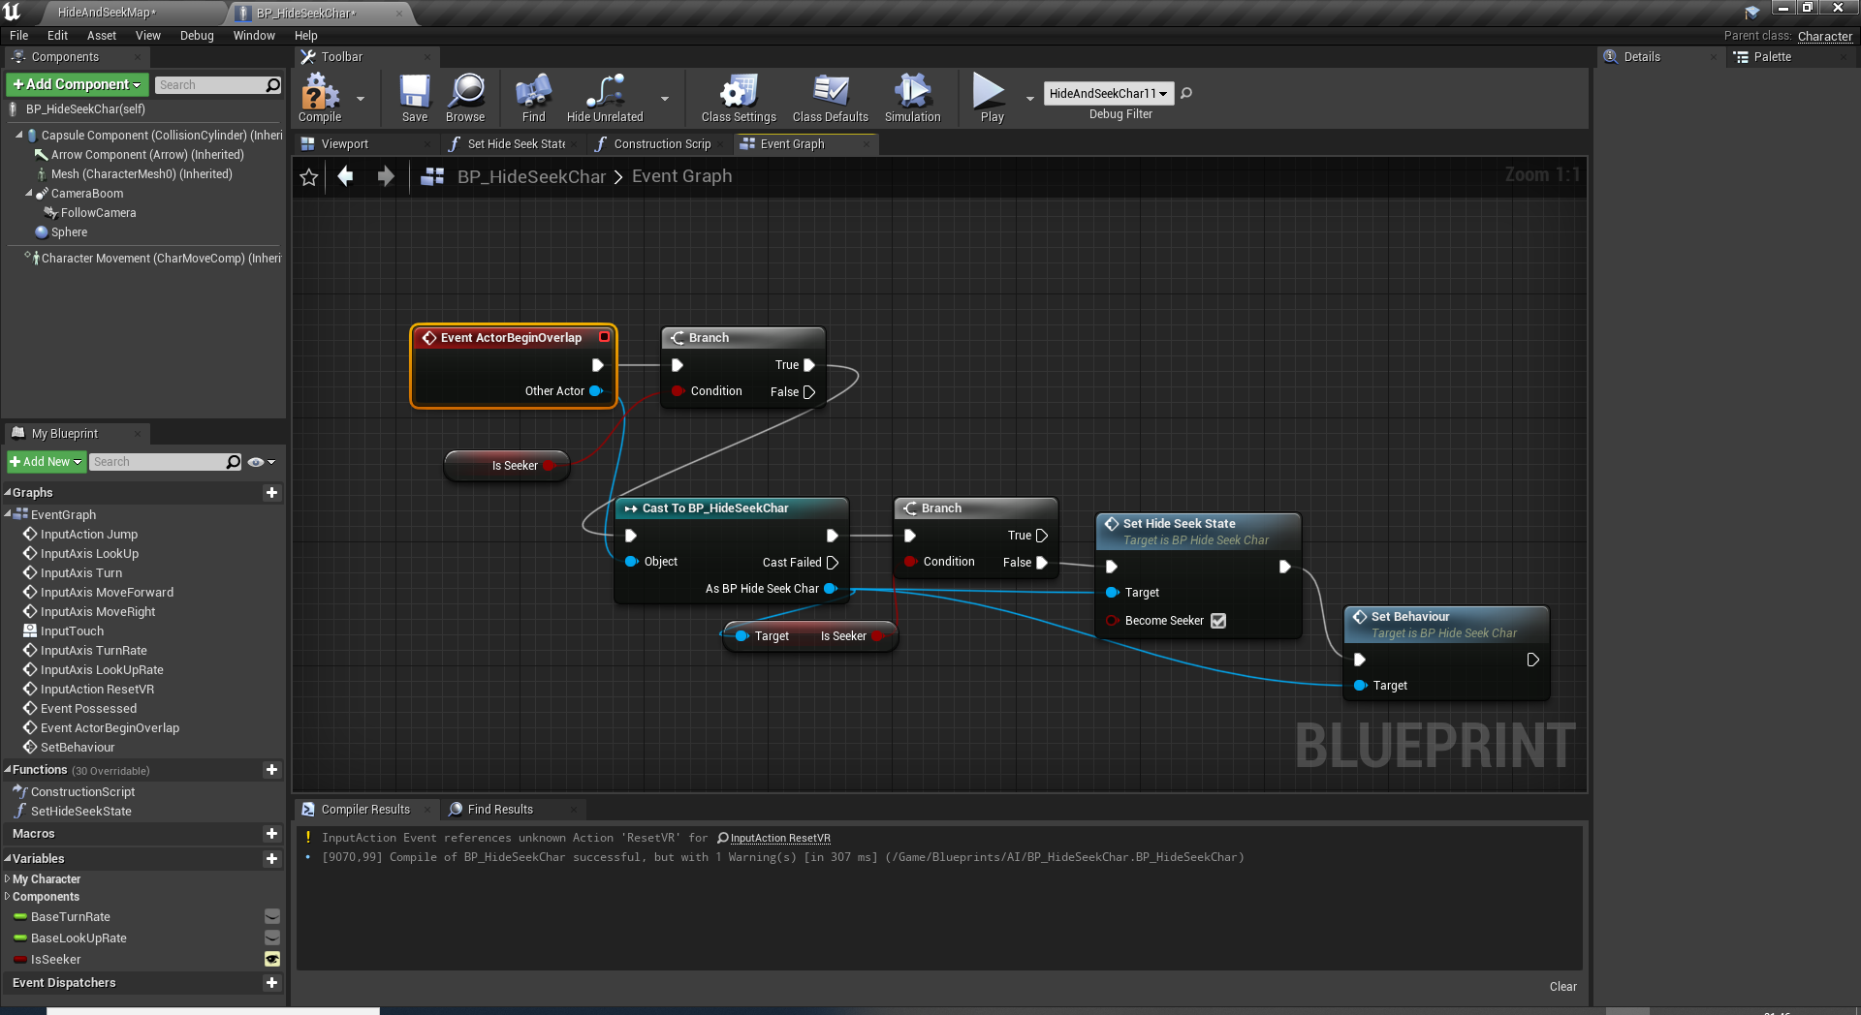
SEEKER CHARACTER SETUP
Add BeginPlay Event and run the correct behaviour tree based on seeker flag.
Also plug another CustomEvent node called SetBehaviour here to use it later.
Implement ActorBeginOverlap to convert hiding players to seekers.

Slide 32
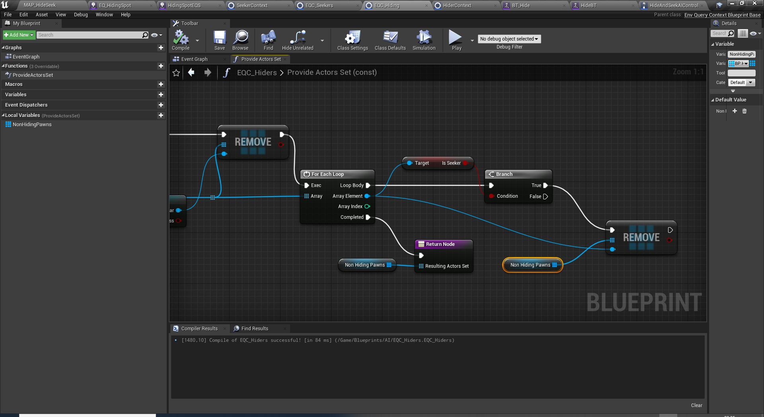
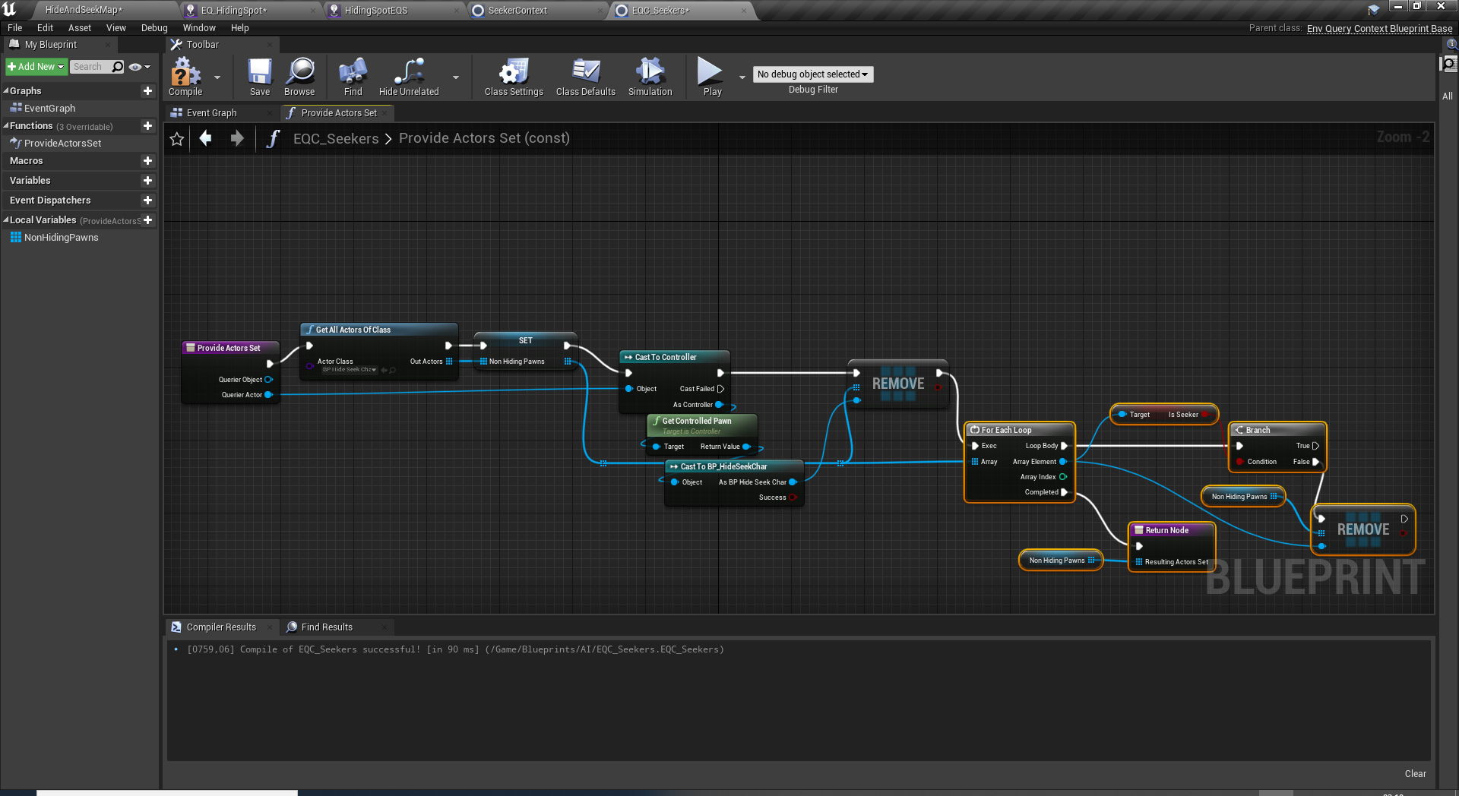
EQS QUERY
Add an Environment Query Blueprint class and name it to EQ_Seeker.
This query will compute the active list of seekers.
Duplicate and rename the asset to EQ_Hiding.
Just change the part where isSeeker branch goes to false.

Slide 33
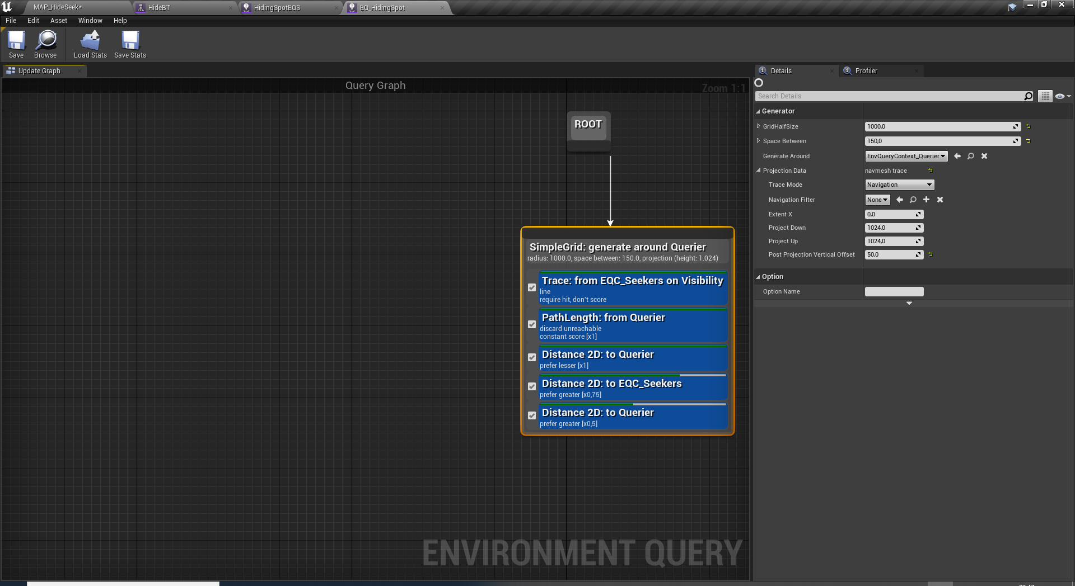
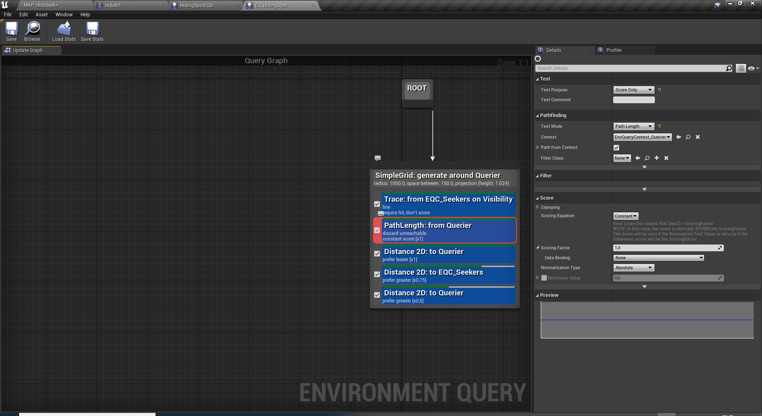
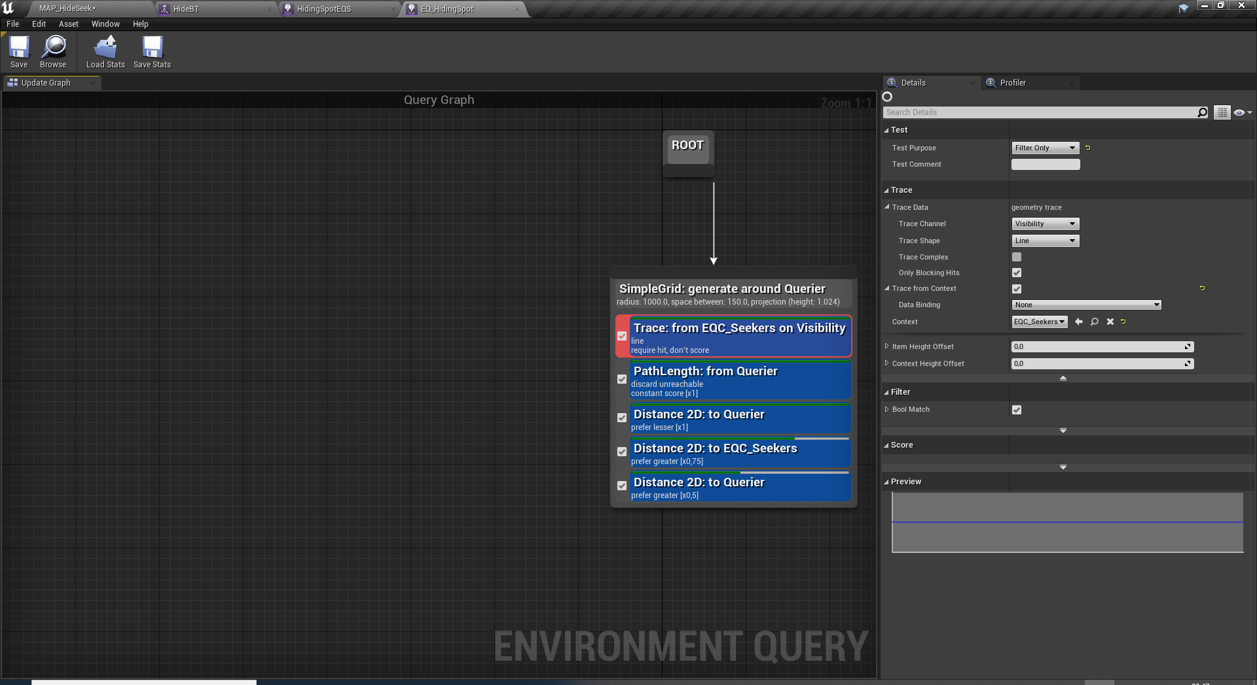
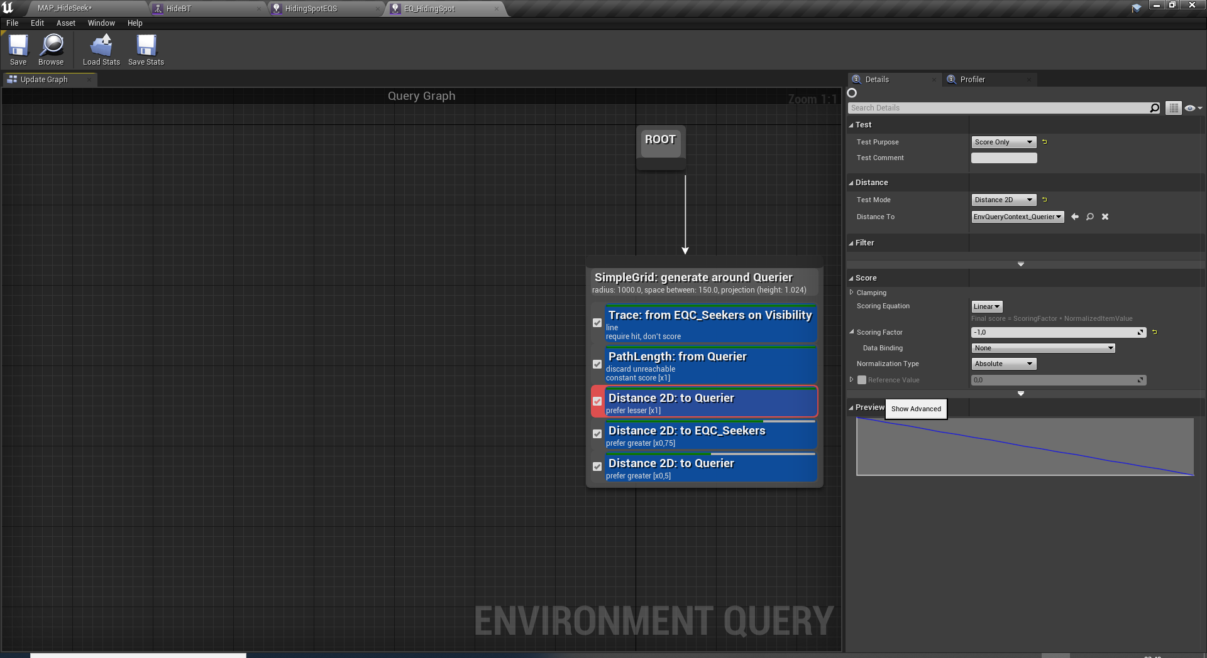
EQS QUERY

Slide 34
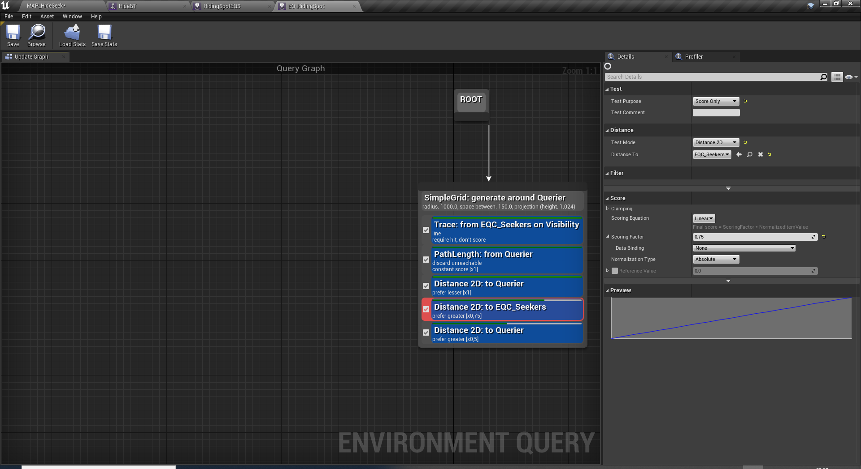
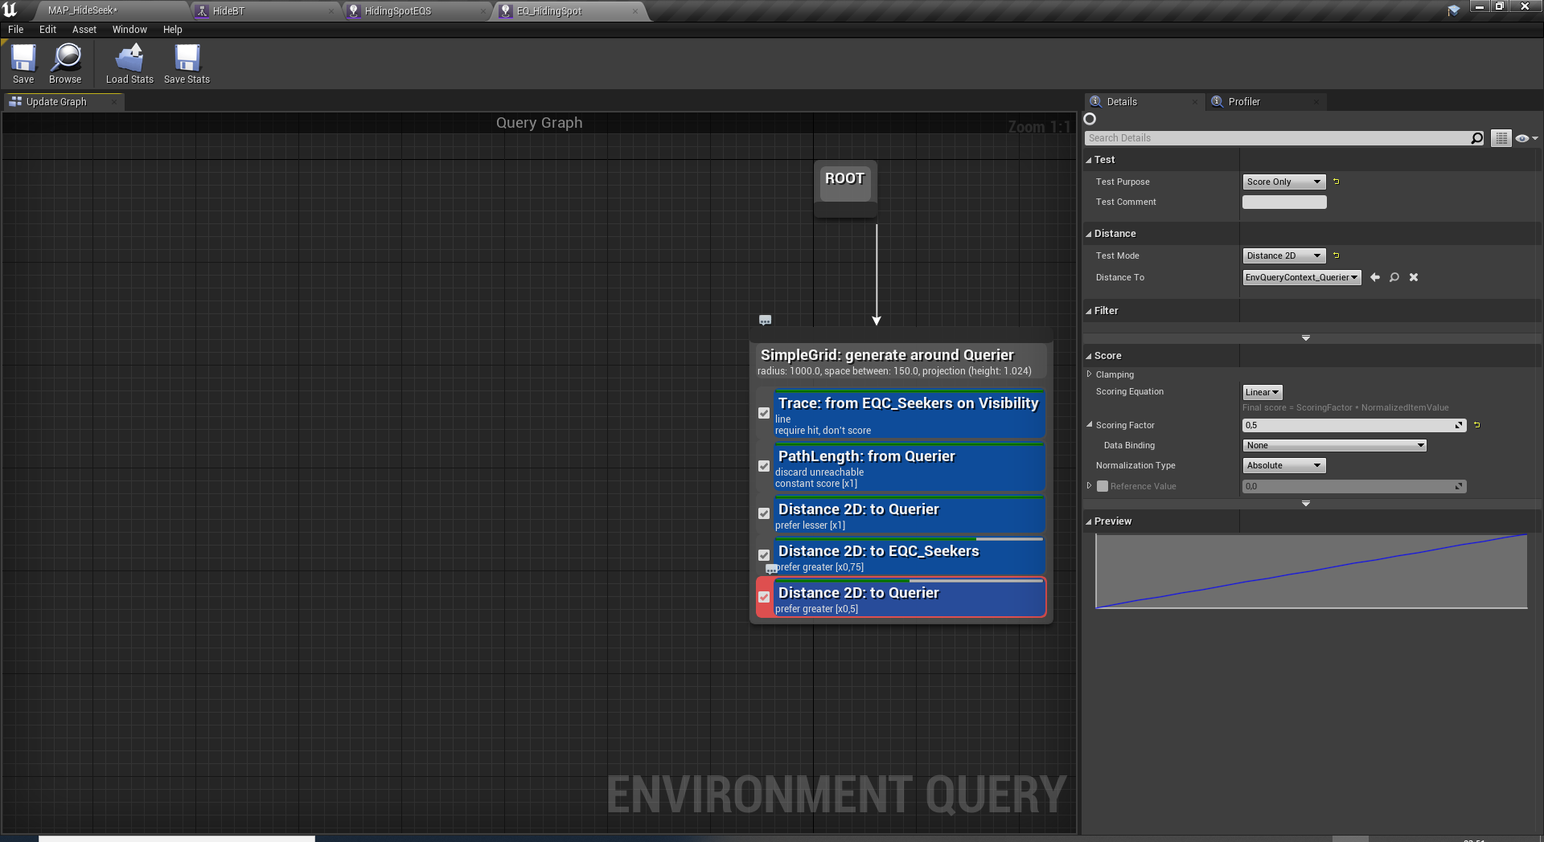
EQS QUERY

Slide 35
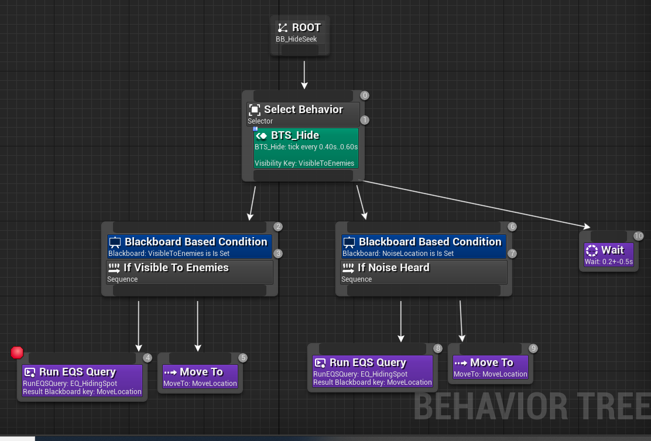
HIDING BEHAVOUR TREE

Slide 36
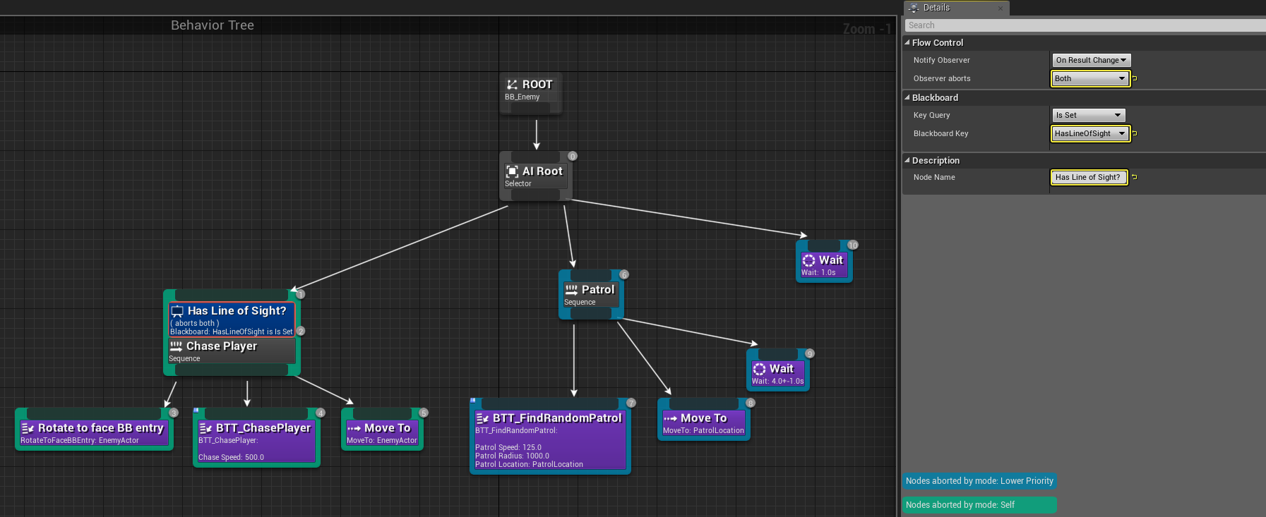
CONDITIONS:
Implement the behavior tree setup below.
Create a testmap to show its working
HINTS AND STEPS:
https://docs.unrealengine.com/4.26/en-US/InteractiveExperiences/ArtificialIntelligence/BehaviorTrees/BehaviorTreeQuickStart/
HOMEWORK:
CHASING/PATROLLING AI

Slide 37
Conclusion
Questions?

